Slide 1
Iron in the Exoplanetary Interior
QMDA Final Project 2019 Fall

Slide 2
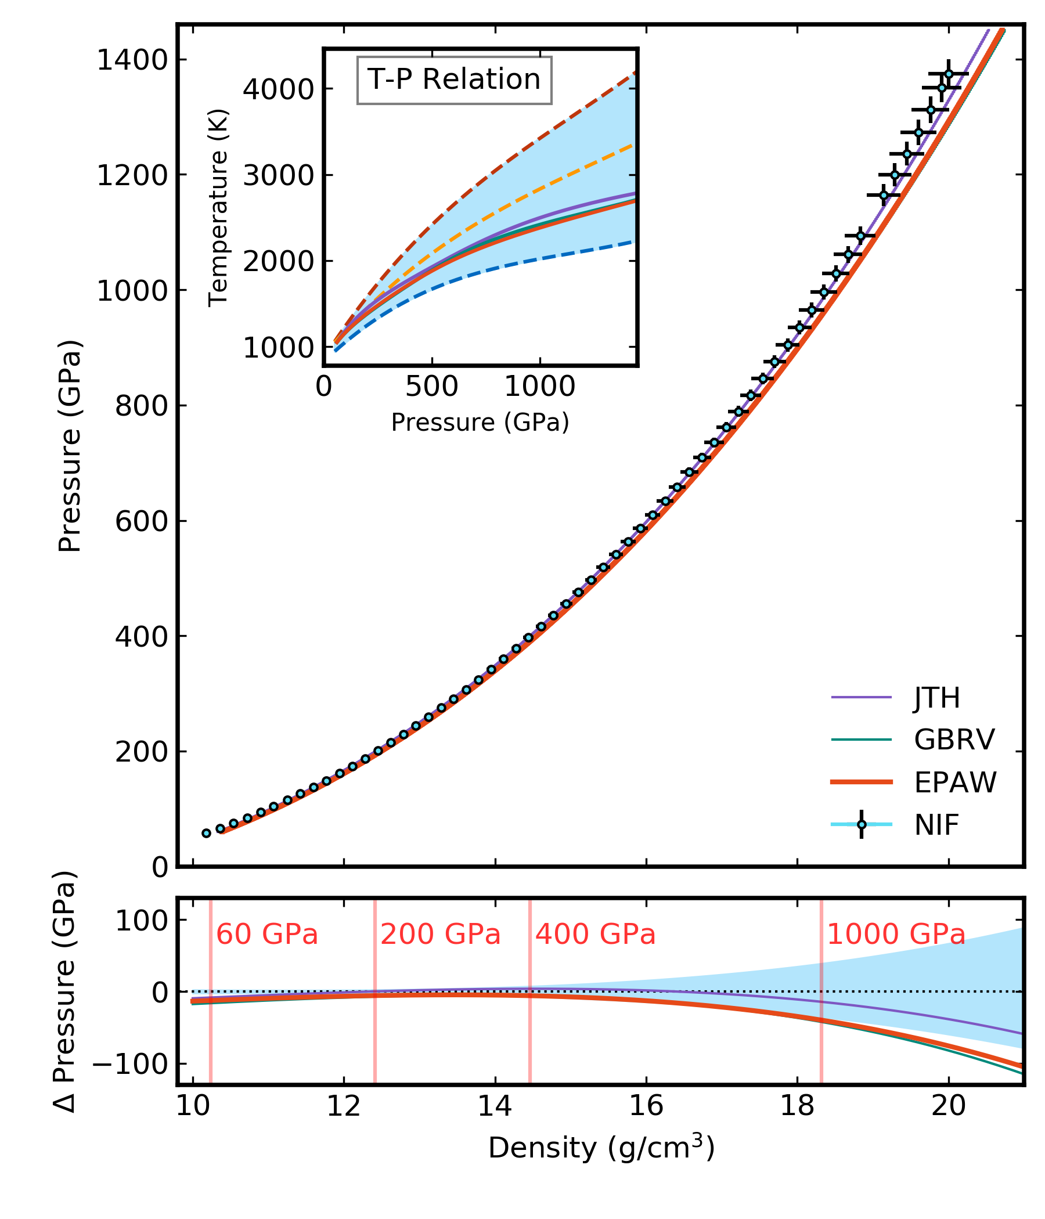

Data
Example of one simulation
At the experiment preferred condition
Data from experiments:
60 discrete points ${(x}_{i}$, $y_{i})$ with error bars $(σ_{x_{i}}$, $σ_{y_{i}})$
Data from simulations:
continuous density vs. pressure ${(d}_{j}$, $p_{j})$along one adiabatic curve
One simulation is using one set of initial condition $T_{0}$, $P_{0}$
16 $T_{0}$ x 21 $P_{0}$ simulations

Slide 3
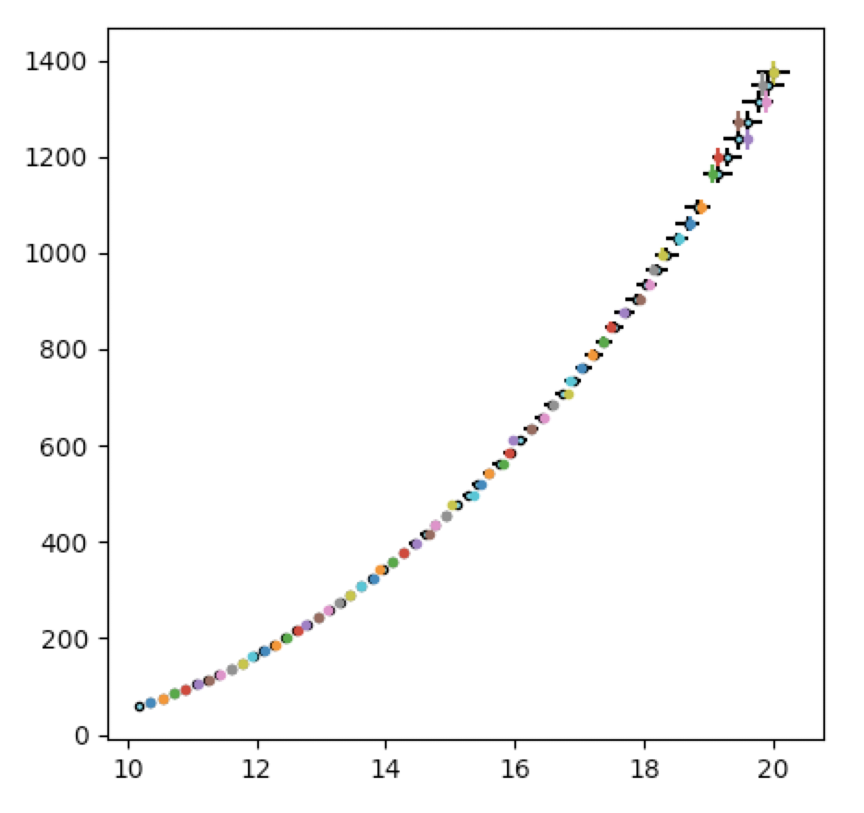
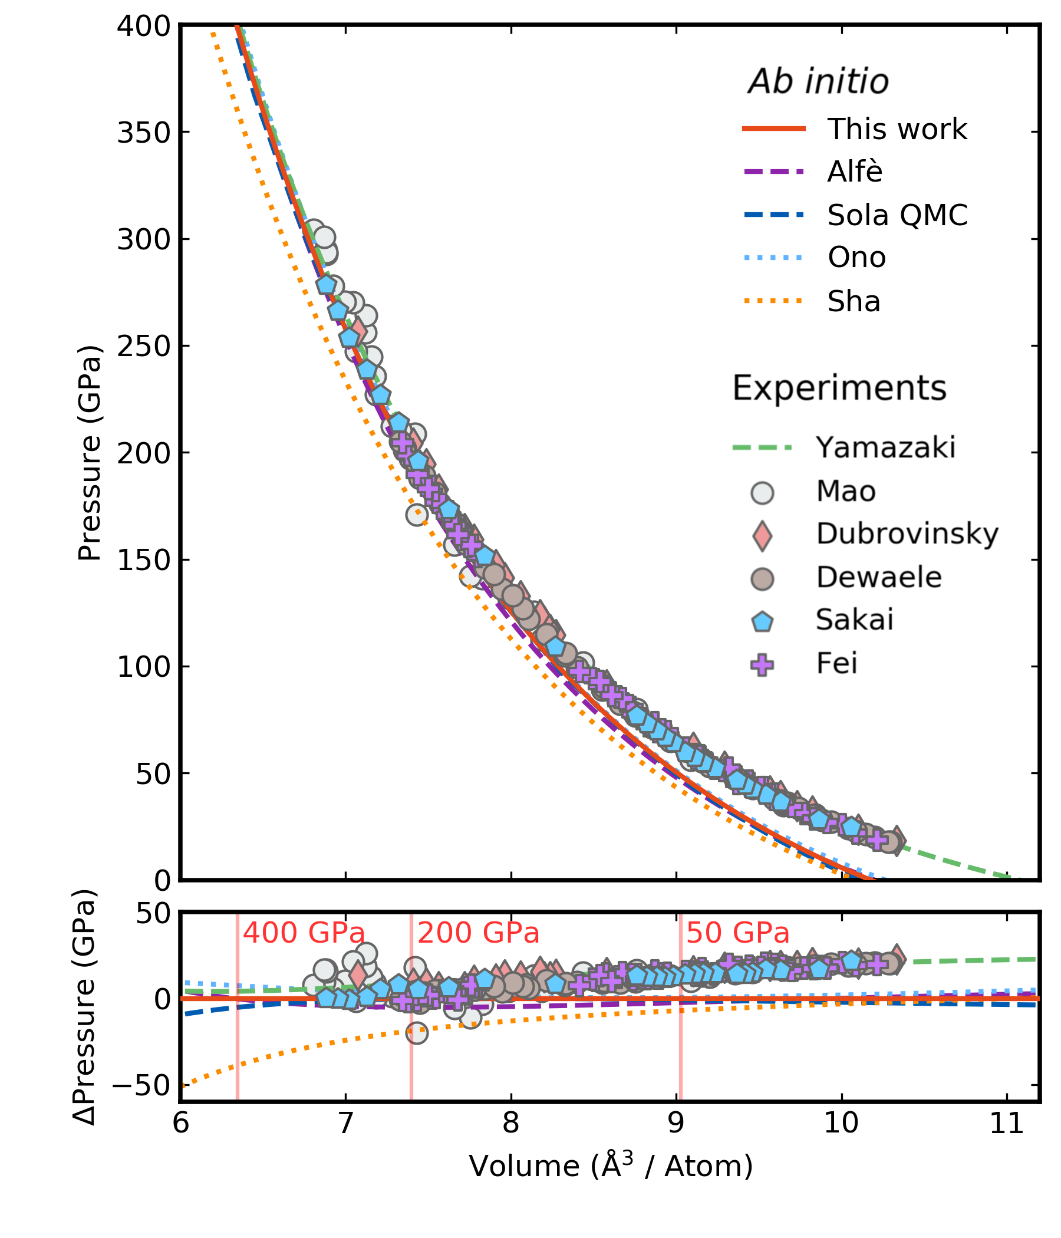
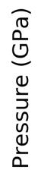
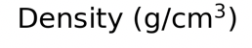
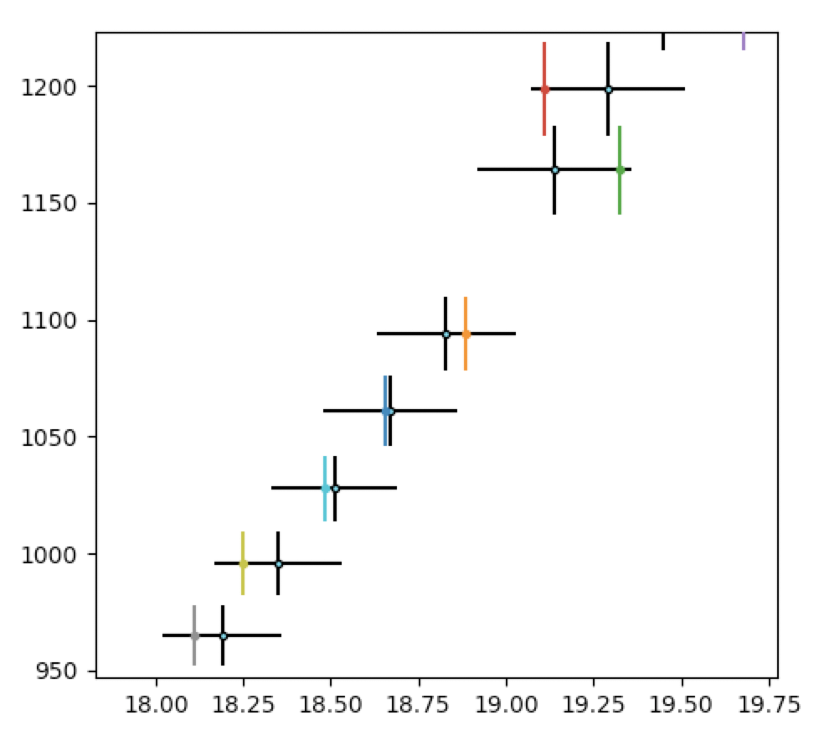
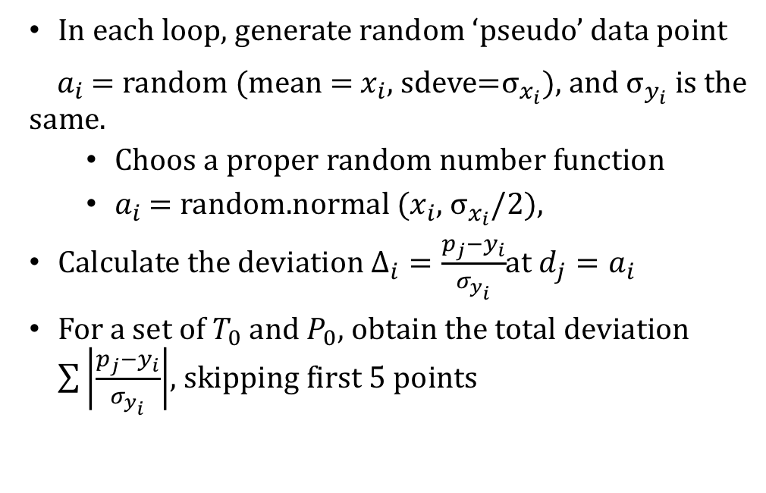
Method: Monte Carlo
In each loop, generate random ‘pseudo’ data point
$a_{i}$ = random (mean = $x_{i}$, sdeve=$σ_{x_{i}}$), and $σ_{y_{i}}$ is the same.
Choos a proper random number function
$a_{i}$ = random.normal ($x_{i}$, $σ_{x_{i}}/2$),
Calculate the deviation $Δ_{i}=\frac{p_{j}−y_{i}}{σ_{y_{i}}}$at $d_{j}=a_{i}$
For a set of $T_{0}$ and $P_{0}$, obtain the total deviation $\sum{\left|\frac{p_{j}−y_{i}}{σ_{y_{i}}}\right|}$, skipping first 5 points
Zoom in

Slide 4
Current Result
Experiment preferred
Minimum deviation
from simulations

